Slide 1

PROJECT 4: BOOTCON
HYDRA
The 3-Headed Brute Force Monster
By: Matthew Forrest, Runa Frye, Joshua Bernstein
Notes:
RUNA
Today, Matt, Josh, and I will be presenting and demonstrating Hydra, which we have dubbed the 3-headed brute force monster.

Slide 2

Hydra Summary
Meet the Monster

Slide 3
What is Hydra?
Open-source login cracker tool developed by The Hacker’s Choice
Supported platforms:
All Unix platforms
MacOS
Windows with Cygwin (both IPv4 and IPv6)
Mobile systems based on Linux, MacOS, or QNX
https://github.com/vanhauser-thc/thc-hydra
Notes:
RUNA
So, what is Hydra? Hydra is an open-source login cracker tool developed by The Hacker’s Choice. It is compatible with Unix, MacOS, Windows, and mobile systems.

Slide 4
Why We Chose Hydra
Pros
Supports over 50 protocols
Can attack multiple targets simultaneously
Optional xhydra GUI
Can be restored if it is killed or crashes
Fewer limitations than cracking tools such as John the Ripper and Aircrack-NG
Cons
Performance impact on target system can increase risk of detection
Might not work on non-standard protocols
Text-based inputs are incompatible with authentication measures such as CAPTCHA
Notes:
RUNA
We chose Hydra for several reasons. First and foremost, it was important for us to choose a tool that is open-source and gets updated regularly. It also comes preinstalled on most Linux systems, supports over 50 protocols, and has an optional GUI known as xhydra.
What makes Hydra unique to other tools we've used during our bootcamp is that it supports parallelized login cracking, which means it can attack multiple targets at once. Other password cracking tools such as John the Ripper and Aircrack-NG have a more limited scope. Another bonus is that if the process is killed or crashes, it can be easily restored to pick up where it left off.
There are a few cons worth noting, however. Although Hydra can be very fast depending on the options used, the faster you run it, the more resource-intensive it becomes, which can increase the risk of detection. Also, Hydra might not work against non-standard protocols, and if a CAPTCHA response is required for a login, Hydra will not be able to perform.

Slide 5



Tool
Best For | Brute force attacks and parallelized login cracking | Single, wordlist, and incremental cracking | Wireless network security and auditing
Compatibility | Unix, MacOS, Windows, mobile systems, 50+ protocols | Primarily used to detect weak Unix passwords | Wireless adapter combined with Linux, MacOS, or Windows
Available Versions | Command line and xhydra GUI | Command line, "jumbo" version, Johnny GUI (must be downloaded separately) | Primarily command line with optional GUI
Performance | Resource-intensive, but options can be used to modify this based on needs | Moderate to high resource intensity | Highly resource-intensive
Community Support | Active community with regular updates | Strong community support and extensive documentation | Established community among wireless security experts
Notes:
RUNA
This shows how Hydra compares to other password cracking tools we've used in the past. As you can see, Hydra excels in versatility and speed, and it's compatible with all major operating systems. So even though Hydra lacks the ability to crack hashes like John the Ripper, the fact that it's suitable for a broader range of penetration testing scenarios makes it a popular choice among security professionals.

Slide 6

Yeah, science!
Research and Preparation
Reviewed multiple how-to guides
Watched video demonstrations
Completed a TryHackMe tutorial
Tested Hydra in the Project2 VM
Set up custom VMs for demo
Notes:
RUNA
While brainstorming ideas for our demonstration, we decided to look into a variety of pentesting tools to find one with capabilities we hadn't yet explored. Once we selected Hydra, we read how-to guides, watched video tutorials, and completed a mini capture the flag exercise on the TryHackMe website to familiarize ourselves with its functionality and syntaxes. We also practiced several exploits in our Project2 VM.
As we worked with Hydra, we realized the VM we were using had limitations that would prevent us from showing its full capabilities. So Josh set up custom VMs on his local machine.
In the next part of our presentation, Matt will go into the basic attack types and commands for Hydra.

Slide 7
Hydra How-To
Basic Attack Types and Commands
Notes:
MATT Now that we know a little bit about what hydra does and how it works, lets take a look at specific examples and see it in action.

Slide 8
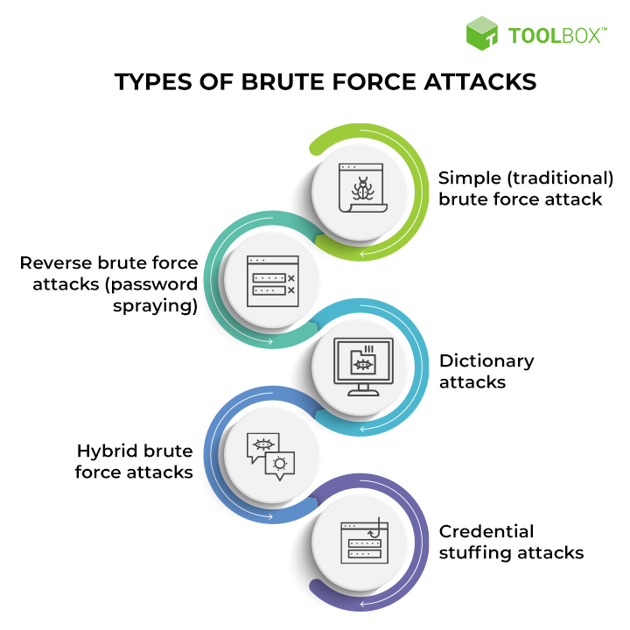
Notes:
MATT There are five main categories of brute force attacks: simple, reverse or password spraying, Dictionary, Hybrid, and credential stuffing. The three main brute force attacks we used and will demonstrate later are simple, password spraying, and dictionary attacks. Lets take a look at our first example.

Slide 9
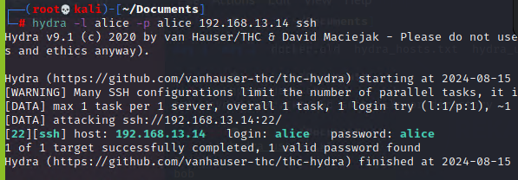
Simple Brute Force
Notes:
MATT This is the syntax for a simple brute force attack. In this example you need 4 things, a username, a password, a server host, and the service. Typically in a simple brute force attack the username and password are credentials you have obtained and should work on the server, in this case alice and alice. Now lets take a look at something not so straight forward.

Slide 10
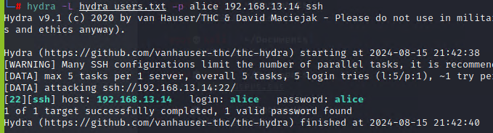
Password Spraying
Notes:
MATT Now what if you don’t know a username, but have managed to get access to a password? The solution is password spraying, also known as reverse brute force. In this case the syntax would be almost identical to the simple brute force, but here we can see that a user txt file is in the place of the username. It is also important to note that the -l is now -L, this tells hydra that the attack is using a file instead of a single name. This file can be created with any text editor, and is composed of possible usernames. The attack then runs the password against all of the usernames from the list and attempts to brute force with each combination. Now we need to deal with the opposite of the last scenario

Slide 11
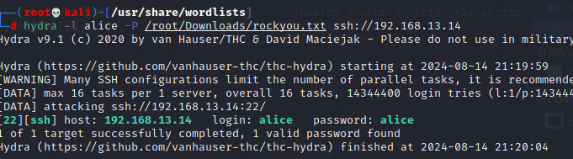
Dictionary Attack
Notes:
MATT. What if we don’t know the password but we do have the username? This is called a dictionary attack. Again it has similar syntax to the original simple brute force attack, but in this case the password is denoted by a -P and has a wordlist in the place of a password. It then runs the command just as before, running the username against a list of possible passwords. If you happen to know potential passwords, you can create your own password file to expedite the attack time. Is this all hydra is good for, absolutely not. Lets take a look at another attack it can do.

Slide 12
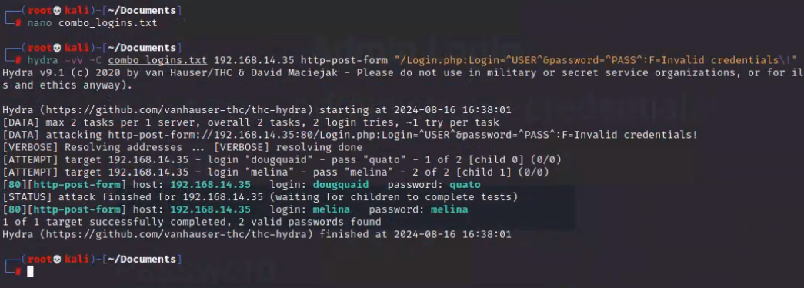
Web Application Brute Force
Notes:
MATT In the previous examples the brute force was on SSH. What if we want to attack a web application? No problem for hydra, the syntax is still the same, you need a username, password, server host, and what service you are using. The only addition is that we now need the syntax the login, which is shown in yellow. The login syntax requires the URL path of the login page that is present after the hostname or ip address. After that you need the correct syntax for a login attempt on the web application. You can see that Login.php is the path we used, and the syntax for the login attempt is login = user & password = pass. User and pass are just placeholders for where the actual credentials we will use in the attack.
And finally the syntax needs the correct response from the web app to know what is an incorrect login.
Now in this example we created a combination text file for the username and password. This allows the user to create a custom list of possible users and passwords, using the designated -C flag, hydra will now run the specific user/password combinations we created rather than running all the usernames against all the passwords.

Slide 13
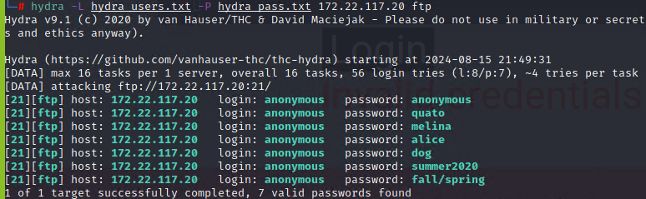
Concurrent Testing on Multiple Logins
Notes:
MATT Hydra also allows for multiple logins simultaneously. So in this example of an anonymous FTP attack, hydra ran 16 logins at the same time, 16 being the default count. But we could also add the task option -t and specify a different number to expedite the attack. With this option, it is possible to run up to 128 tasks at a time. However, if we set the number too high, we run the risk of triggering an intrusion detection system like Snort or disabling the targeted service entirely.
Think of it this way: If you drop one marble on a table, no one will hear it. If you drop 200 marbles, people are going to try to find the noise.

Slide 14

But Wait, There’s More…
Commands* to enhance the hydra attack:
Specify a port
Set the number of threads
Define the length of a password
Resume previous attacks
Attack multiple servers
*hydra command generator: https://www.stationx.net/how-to-use-hydra/
Notes:
MATT But wait there’s more, Hydra has a number for flags that allow for greater control over the attack. There are advanced commands that allow you to specify a number of criteria to enhance your attack. This ranges from designating a specific port, how many threads (the number of simultaneous logins), length of passwords you will attempt, and even attack multiple servers. For a more in depth look at those commands, run the help command, hydra -h. This will pull up the entire syntax for a hydra attack. If you can’t remember what all these commands do or how to execute them, there are hydra command generators you can use to create the command for you.

Slide 15
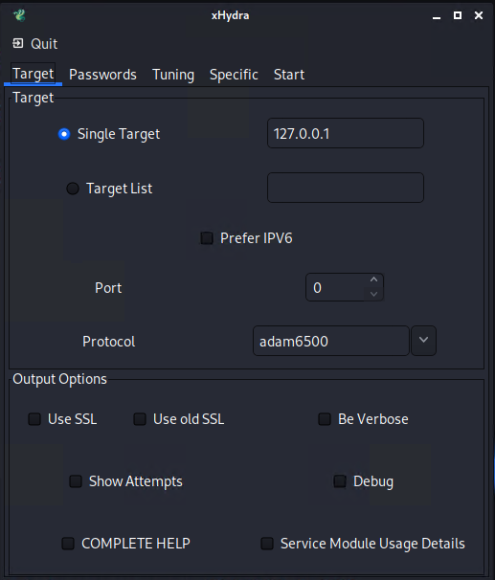
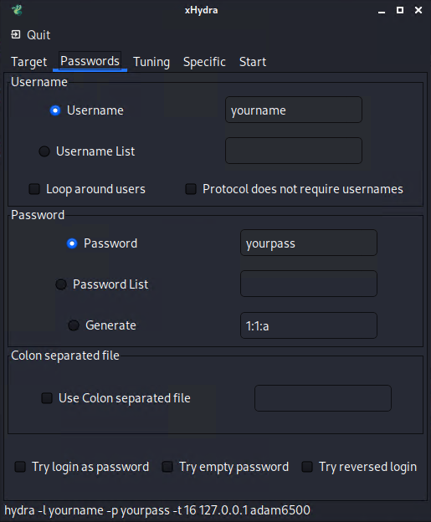
xHydra
1
4
2
5
3
Notes:
MATT OK We’ve gone over the command line syntax, but I hear you, you want a more visual display. We got you covered, hydra comes with a GUI that can be accessed from the command line by running the command xhydra. What will come up are the images you see here, a new window with multiple tabs. Each of these tabs allows you to enter specific information about the attack you are trying to conduct.
Here in our images we have the markers 1 through 5. Marker one is where you can designate the target or a list of targets you want to attack. Markers 2 and 3 are where you can specify the port and protocol you wish to exploit. And finally 4 and 5 are where you can enter the username and passwords.

Slide 16



Demonstration
Notes:
For the purpose of our demonstration, we chose to target SSH and RDP protocols on Windows 11 OS, as well as the HTTP protocol on Ubuntu OS featuring WebGoat, an insecure web application. The Telnet protocol was also attacked using the Ubuntu OS. Finally, FTP protocol was attacked on the intentionally vulnerable Metasploitable 2 linux virtual machine.
Our goal is to show how hydra can be used to crack weak passwords and gain access to these systems. The methods we have chosen are brute force, dictionary attack, and password spraying.
Since hydra was preinstalled on our Linux system, the only setup we needed to do for our exploit is perform an nmap/zenmap scan to determine vulnerable ports, as well as create text files of known and suspected credentials.
Old notes (don't need to read these unless you wanna):
Networking Concepts
Protocols & Ports- Hydra interacts with various network services like SSH, FTP, and HTTP to test login security. Understanding these protocols helps in configuring hydra for effective testing
Security Concepts
Password Vulnerabilities: Demonstrates how weak/common passwords can be exploited using brute force and dictionary attacks.
Attack Strategies: Uses brute force (testing all combinations) and dictionary attacks (testing common passwords) to uncover vulnerabilities in authentication mechanisms

Slide 17
Summary
Demo Recap and Potential Impact
Notes:
JOSH:
To recap what was just demonstrated, we successfully breached megacorpone's Linux server through the SSH and FTP ports using brute force, dictionary, and password spraying attacks. We were able to accomplish this by taking advantage of weak credentials.
We also breached the Login.php page of the Rekall web app by exploiting the HTTP POST protocol, which we were able to accomplish due to vulnerabilities in Rekall's authentication mechanisms.
These exploits were relatively simple and fast to perform, yet could have substantial consequences for a business.

Slide 18
Demonstration Recap
Host: Kali Linux 2024.2- 192.168.56.104
Target 1: Ubuntu with Web Goat 192.168.56.105 (http-post-form)
Target 2: Metasploitable 2 192.168.56.106 (FTP)
Target 3: Windows 11 Home 192.168.56.107 (SSH)
Target 4: Windows 11 Enterprise 192.168.56.108 (RDP)
Target 5: Ubuntu 24 192.168.56.109 (Telnet)
Notes:
JOSH

Slide 19
Tools Used
Oracle VM Virtual Box 7.0- https://www.virtualbox.org/wiki/Downloads
Metasploitable 2- https://sourceforge.net/projects/metasploitable/
Kali Linux 2024.2- https://www.kali.org/get-kali/#kali-virtual-machines
THC-Hydra https://github.com/vanhauser-thc/thc-hydra
Ubuntu 24.04LTS- https://ubuntu.com/download/desktop
Remmina- Github & Direct Download
Nmap- Github & Direct Download
Notes:
JOSH

Slide 20

Potential Impact
Sensitive data leaks
Financial loss
Stolen intellectual property
Online vandalism
Reputational damage
Notes:
RUNA
So Josh has demonstrated how fast and easy it is to exploit vulnerable protocols using Hydra. And as we know, when servers are breached, the potential impacts can be catastrophic. Confidential data can be stolen and potentially monetized. Companies can suffer financial losses through investigation costs and legal fees. Intellectual property such as designs, strategies, and blueprints may be stolen. Cybercriminals can also alter web apps to redirect users to malicious sites, intercept sensitive data, or cause a disruption of service. And of course, major breaches can lead to reputational damage and loss of customers and revenue.
Small-to-midsize businesses are especially vulnerable, as they generally lack the resources and skills to combat an attack. Therefore it is essential to use proper mitigation strategies to proactively defend against Hydra attacks.

Slide 21
Mitigation
Defending Against Hydra Attacks
Notes:
RUNA
(Nothing to say here...)

Slide 22
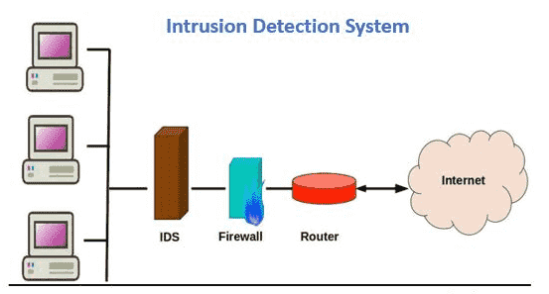

Mitigating Hydra Attacks
Keep systems updated
Implement account lockout
Set up multi-factor authentication and/or CAPTCHA
Follow NIST password guidelines
Use IDS
Monitor and restrict access
Attacker
Notes:
RUNA
The methods for defending against Hydra attacks are the same as what would be used to defend against any password cracking tool. We want to ensure systems are kept up-to-date, lock user accounts after several failed login attempts, set up multi-factor authentication, consider using CAPTCHA, follow NIST best practices for password security, use an IDS such as Snort, monitor logins, and consider restricting login access based on IP or role.
This concludes our Hydra presentation. We appreciate everyone listening when we know you're all a little preoccupied with your own presentations right now. Please let us know if you have any questions for us!

Slide 23

Questions
?
???
?
?
?
?
???
?
?
?
???
?
???
?
?
?
???
?
???

